Slide 1


Software Engineering
Understanding the Foundation of Modern Technology

Slide 2

Interactive discussion - 5 minutes
”Apa pengalaman programming terberat kalian?"
Notes:
Code yang tidak bisa di-debug
Project yang tidak pernah selesai
Kerja sama tim yang kacau
Code yang sulit dipahami setelah beberapa bulan

Slide 3

Interactive discussion - 5 minutes
”Apa pengalaman programming terberat kalian?"
”Dengan course ini kita akan belajar bagaimana menghindari masalah-masalah ini!"
Notes:
Code yang tidak bisa di-debug
Project yang tidak pernah selesai
Kerja sama tim yang kacau
Code yang sulit dipahami setelah beberapa bulan

Slide 4

What is Software Engineering?
Programming vs Software Engineering
Programming | Software Engineering
🔧 Writing code | 🏗️ Building systems
🎯 Solve immediate problem | 📋 Manage entire lifecycle
👤 Individual activity | 👥 Team collaboration
⚡ Quick solutions | 🔄 Long-term maintenance
Notes:
🎓 Untuk Pemula (Semester 1-3)
Bayangkan kalian baru belajar masak:
Programming: Kalian bisa masak mie instan untuk diri sendiri. Cepat, simple, asal kenyang.
Software Engineering: Kalian buka warung mie. Harus pikirkan menu, harga, pelayan, kebersihan, stok bahan, customer service, dll.
Contoh Sederhana:
Programming: Buat calculator sederhana untuk tugas
Software Engineering: Buat aplikasi keuangan untuk 1000 user dengan login, database, backup, security

Slide 5

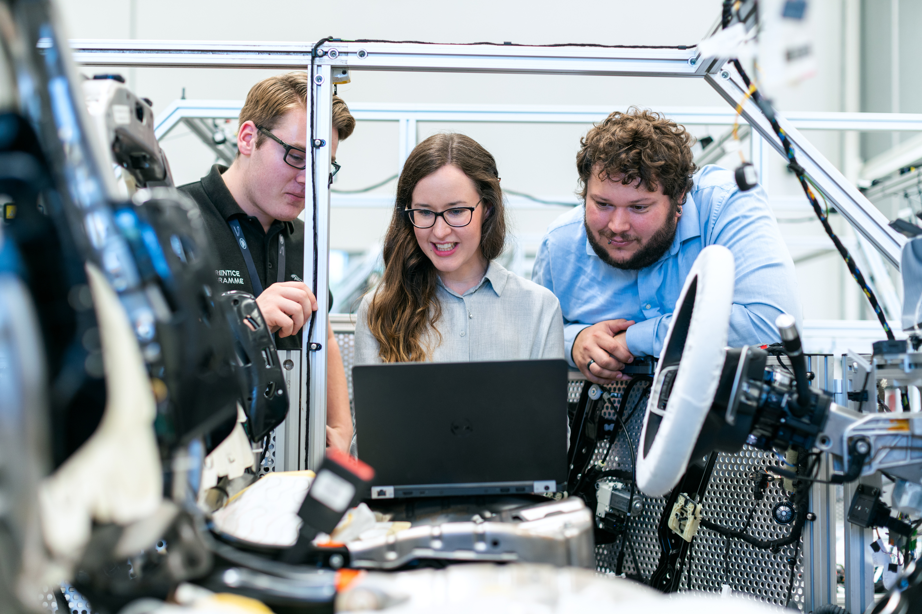



Why Software Engineering matters?
Real-world example:

Slide 6

Modularity
Abstraction
Break big problems into smaller pieces
Hide complexity behind simple interfaces
Encapsulation
Separation of Concern
Bundle data and methods together
Each component has one clear responsibility
Fundamental Principles

Slide 7
Interactive Exercise
Show screenshot of a familiar app
Group Discussion:
What are the main components?
How do they demonstrate modularity?
What abstractions do you see?
How are concerns separated?

Slide 8
Development Methodologies
How we build software
🌊 Waterfall
Sequential phases
Requirements → Design → Code → Test → Deploy
Good for: Clear requirements, regulated industries
Example: Banking systems, medical devices
🔄 Agile
Iterative development
Short sprints, frequent feedback
Good for: Changing requirements, startups
Example: Mobile apps, web applications

Slide 9
Methodology Comparison
When to use which?
Scenario | Waterfall | Agile
🏦 Banking system | ✅ | ❌
📱 Social media app | ❌ | ✅
🚀 NASA mission software | ✅ | ❌
🛒 E-commerce startup | ❌ | ✅
📚 University project | ✅ | ✅
Scenario Indonesia | Waterfall | Agile | Alasan
🏛️ Sistem e-KTP | ✅ | ❌ | Regulasi pemerintah ketat, requirements jelas
📱 Aplikasi startup (Traveloka awal) | ❌ | ✅ | Market validation, pivot cepat
🏥 Sistem rumah sakit | ✅ | ❌ | Safety critical, compliance
🎮 Game mobile Indonesia | ❌ | ✅ | User feedback, frequent updates
📚 Sistem akademik kampus | ✅ | ✅ | Depends on scope dan timeline
🛒 Tokopedia/Shopee features | ❌ | ✅ | A/B testing, user behavior analysis

Slide 10
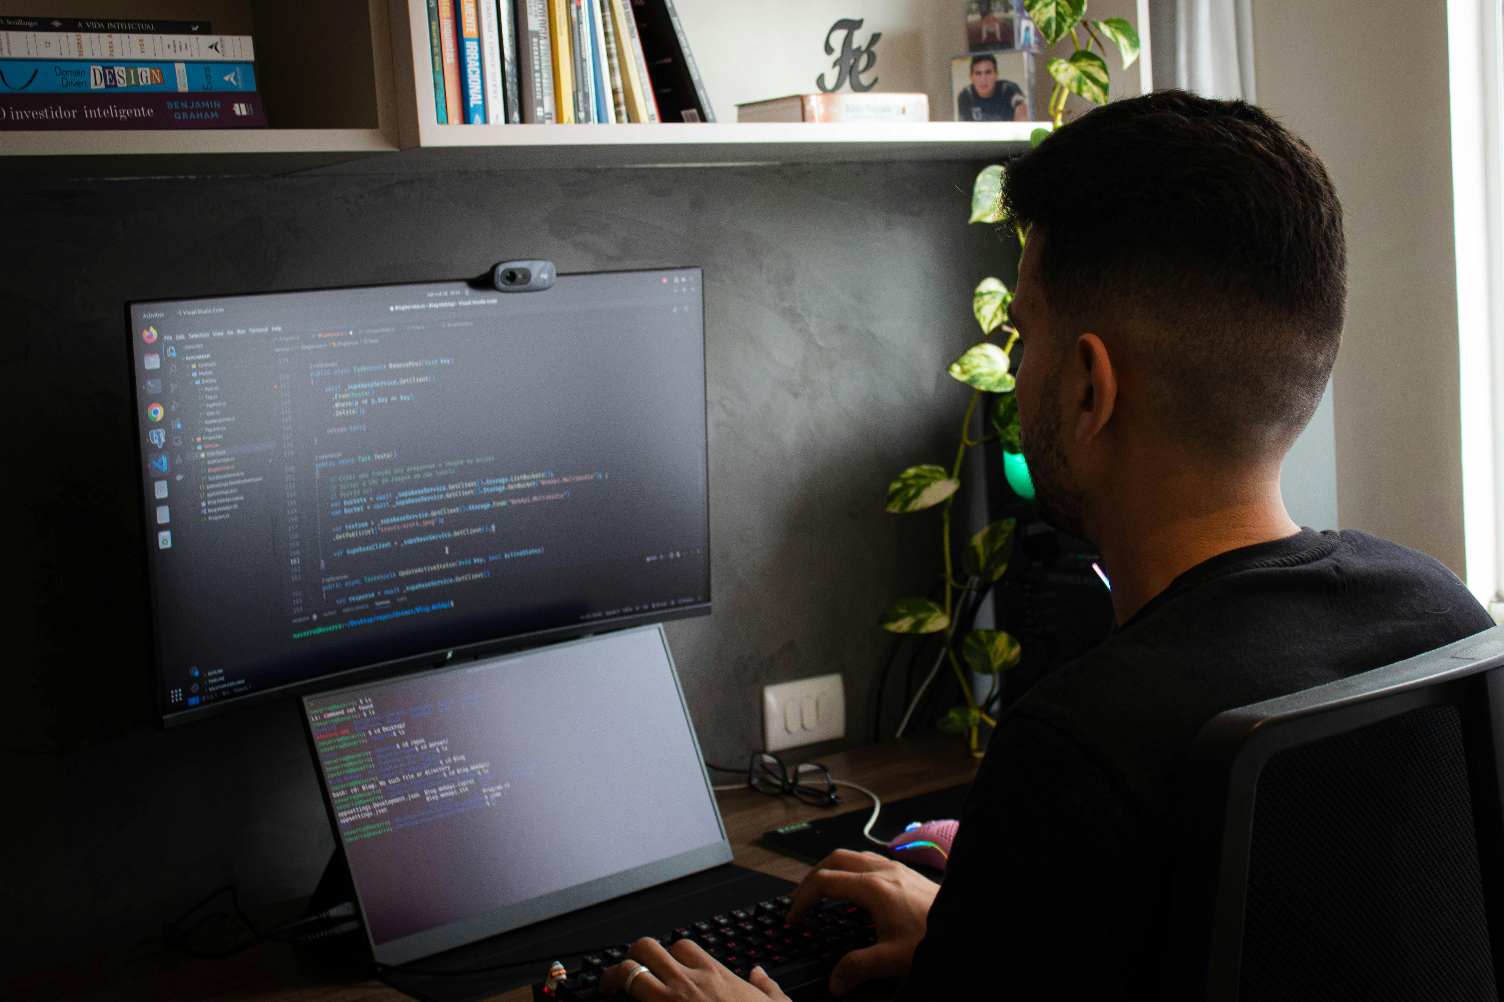
Quiz Time!
1. What's the difference between programming and software engineering?
A) No difference
B) SE focuses on entire lifecycle
C) Programming is harder
2. Which principle helps us manage complexity?
A) Modularity
B) Abstraction
C) Both A and B
3. When should we use Agile methodology?
A) Requirements are clear and fixed
B) Requirements might change
C) Never

Slide 11
Questions & Discussion

Slide 12
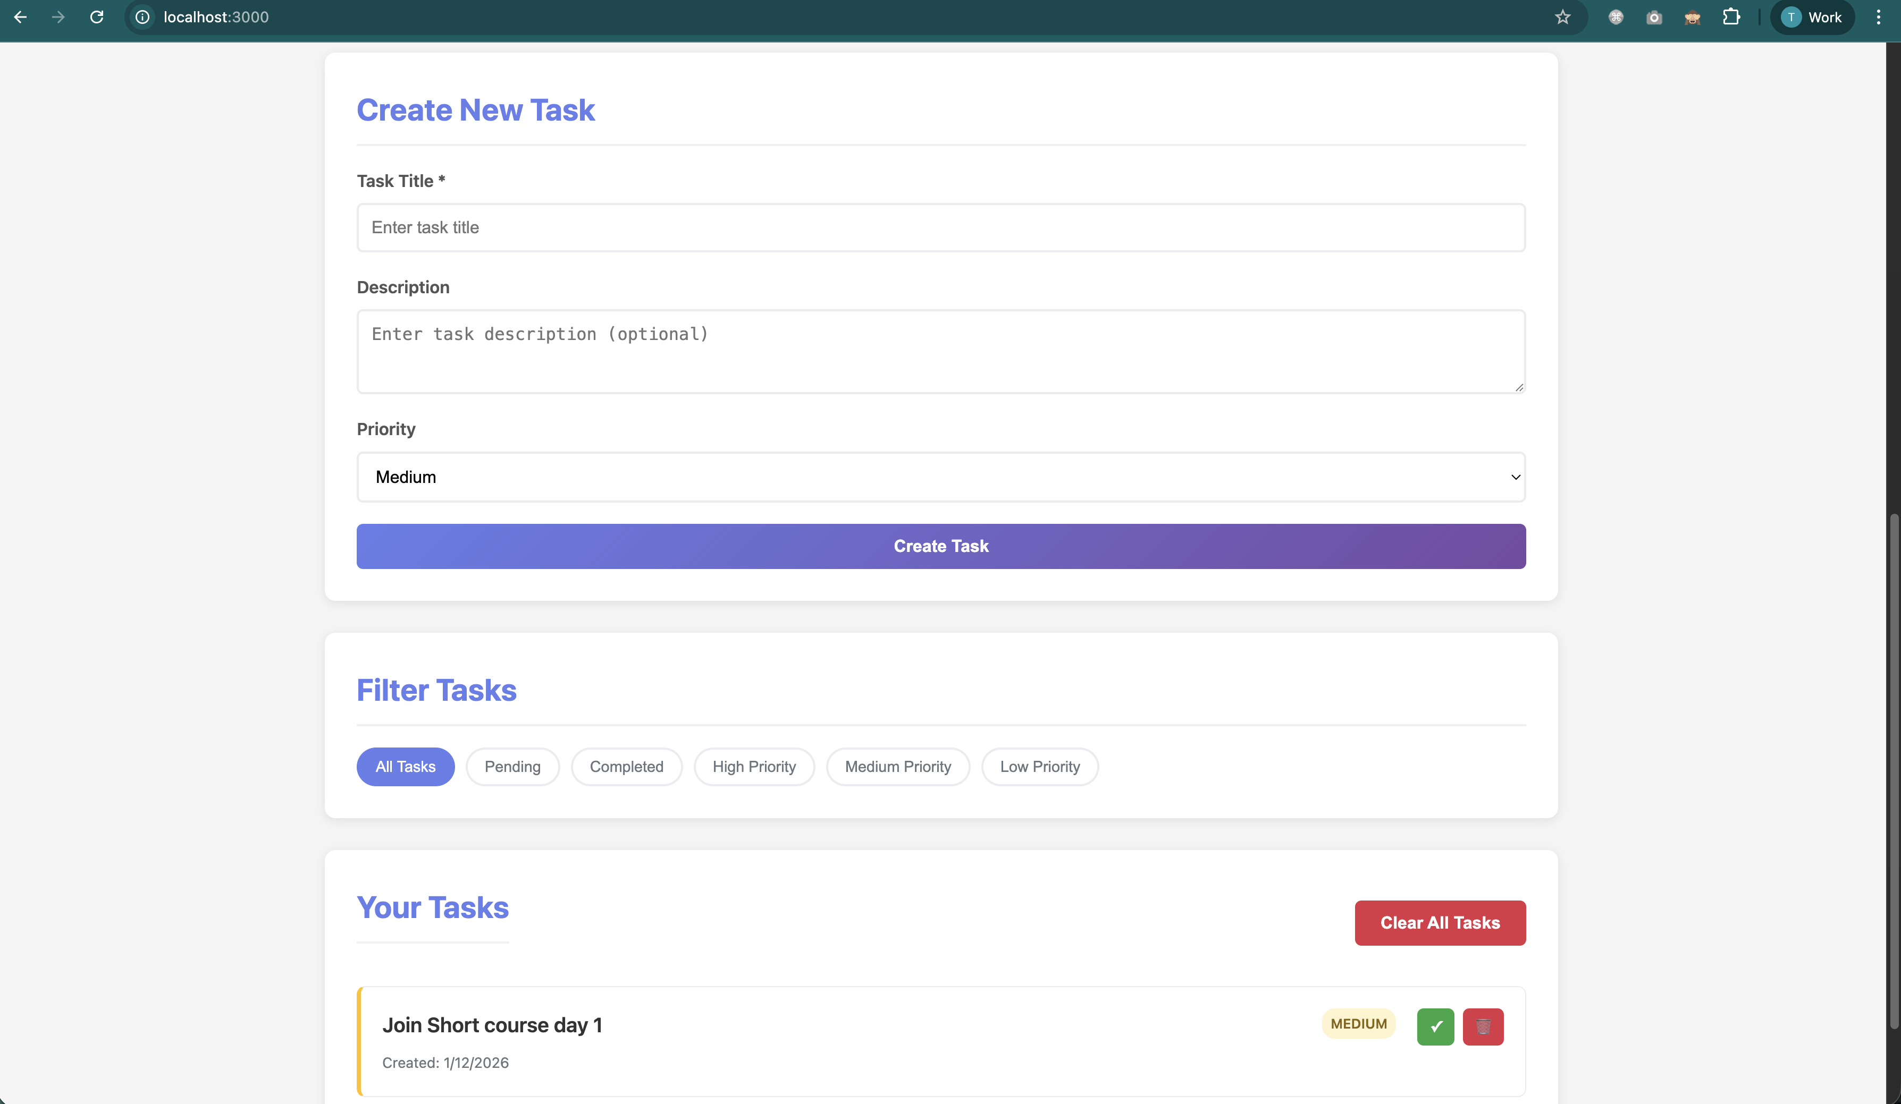
Our Project Introduction: Task Management System
🎯 Why This Project?
Simple enough to complete in 5 days
Complex enough to demonstrate all SE principles
Familiar domain - everyone uses task managers
Scalable - can add features incrementally
🛠️ Technology Stack
Simple enough to complete in 5 days
Complex enough to demonstrate all SE principles
Familiar domain - everyone uses task managers
Scalable - can add features incrementally

Slide 13
Project Features Overview Task Management System
What will we build
📋 Core Features
✅ Create, edit, delete tasks
🏷️ Categorize and prioritize tasks
📅 Set due dates and reminders
👤 User authentication and profiles
👥 Share tasks with others
🎨 SE Principles Applied
Modular architecture (MVC pattern)
Clean abstractions (Service layer)
Proper encapsulation (Data models)
Separated concerns (Controllers, Services, Repositories)

Slide 14
Project Structure Preview Task Management System
How We'll Organize Our Code
task-manager/
├── src/
│ ├── models/ # Data structures (Task, User)
│ ├── controllers/ # Handle HTTP requests
│ ├── services/ # Business logic
│ ├── repositories/ # Data access
│ └── utils/ # Helper functions
├── tests/ # Automated tests
├── docs/ # Documentation
└── package.json # Project configuration
🎨 SE Principles in Action
🧩 Modularity: Separate folders for different concerns
🎯 Separation: Controllers ≠ Services ≠ Data Access
📦 Encapsulation: Each module has clear interface

Slide 15
Development Environment Setup
Tools We'll Use
💻 Required Software
Node.js (v14+): JavaScript runtime
npm: Package manager
VS Code: Code editor (recommended)
Git: Version control
🔧 Setup Checklist
[ ] Node.js installed and working
[ ] npm can install packages
[ ] Code editor configured
[ ] Terminal/command prompt accessible
[ ] Git installed (for tomorrow)

Slide 16
Best Practices from Day 1
Start with Good Habits
📝 Naming Conventions
Variables: taskTitle, userEmail (camelCase)
Functions: createTask(), validateUser() (verbs)
Files: TaskService.js, user-controller.js
Folders: models/, services/, tests/
📁 Code Organization
One class per file
Group related files in folders
Clear file and folder names
Consistent structure across project
📚 Documentation
README.md explains project setup
Comments explain WHY, not WHAT
Function descriptions for complex logic

Slide 17
What We'll Accomplish Today
Day 1 Goals
✅ By End of Today
[ ] Understand SE fundamentals and principles
[ ] Have development environment set up
[ ] Create basic project structure
[ ] Implement first Task model
[ ] Apply SE principles to code organization

Slide 18
Wrap-Up
Key Takeaways
🧠 Concepts Learned
Software Engineering vs Programming
Four fundamental SE principles
Waterfall vs Agile methodologies
Importance of good project structure
💻 Practical Skills
Development environment setup
Project structure creation
Basic Task model implementation
SE principles application

Slide 19



Thank You
Get In Touch
+62-822-1367-2972
http://toni.Kusnandar.dev
toni@Kusnandar.dev

